Slide 1
MATHEMATICS FOR ECONOMICS COURSE I - Mathematical Preliminary
INSTRUCTOR:
Professor MIHAELA PAUN

Slide 2
Mathematics is a game played according to certain
simple rules with meaningless marks on paper.

Slide 3
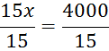
1. ARITHMETIC OPERATIONS
Brackets in mathematics are used for grouping and clarity. Brackets may also be used to indicate
multiplication.
Variables and letters: When we don't know the value of a quantity, we give that quantity a
symbol, such as x. We may then make general statements about the unknown quantity, x.
Example: For the next 15 weeks, if I save $x per week I shall have $4000 to spend on a holiday.
This statement may be expressed as a mathematical equation:
15 * weekly savings = 4000
15 * x = 4000 or 15*x = 4000
Now that the statement has been reduced to a mathematical equation, we may solve the
equation for the unknown, x:
15x =4000 divide both sides of the equation by 15
x = 266.67

Slide 4
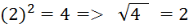
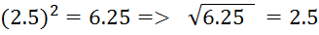
Square roots: the square root of a number is the reverse of squaring:
Adding: If all the signs are the same, simply add all the terms and give the answer with
the common overall sign.
Subtracting: When subtracting any two numbers or two similar terms, give the answer
with the sign of the largest number or term.
Add/subtract with numbers Add/subtract with variable terms
5+8+3=16 5x + 8x + 3x = l 6x
5+8+3+y=16+6 (i) 5x + 8x + 3x + y = 16x + y
(ii) 5xy + 8xy + 3xy + y = 16xy + y
The y·term is different, so it cannot be added to the others

Slide 5
Remember:
A minus sign is a -1; hence -5 is the same as -1 x 5;
0 x (any real number) = 0
0 : (any real number) = 0
But you cannot divide by 0
The following identities are important:
Brackets are used for grouping terms together in mathematics for:
Clarity
Indicating the order in which a series of operation should be carried out

Slide 6
2. FRACTIONS
Terminology:
3 is called the numerator
7 is called the denominator
The method for adding or subtracting fractions is:
Step 1: Take a common denominator, that is, a number or term which is divisible by the denominator of each fraction to be added or subtracted. A safe bet is to use the product of all the individual denominators as the common denominator.
Step 2: For each fraction, divide each denominator into the common denominator, then multiply the answer by the numerator.
Step 3: Simplify your answer if possible.

Slide 8
Multiplying fractions
In multiplication, write out the fractions; multiply the numbers across the top lines
and multiply the numbers across the bottom lines.
Note: Write whole numbers as fractions by putting them over 1.

Slide 9
Dividing by a fraction is the same as multiplying by the fraction inverted.

Slide 10
3. SOLVING EQUATIONS
The solution of an equation is simply the value or values of the unknown(s) for which the left-
hand side (LHS) of the equation is equal to the right-hand side (RHS).
For example, the equation, x + 4 = 10, has the solution x = 6. We say x = 6 'satisfies' the equation.
We say this equation has a unique solution.
Not all equations have solutions. In fact, equations may have no solutions at all or may have
infinitely many solutions. Each of these situations is demonstrated in the following examples.
Case 1: Unique solutions An example of this is given above: x + 4 = 10 etc.
Case 2: Infinitely many solutions. The equation, x + y = 10 has solutions (x = 5, y = 5); (x = 4, y =
6); (x = 3, y = 7), etc. In fact, this equation has infinitely many solutions or pairs of values (x, y)
which satisfy the formula, x + y = 10.
Case 3: No solution. The equation, 0(x) = 5 has no solution. There is simply no value of x which
can be multiplied by 0 to give 5.

Slide 11
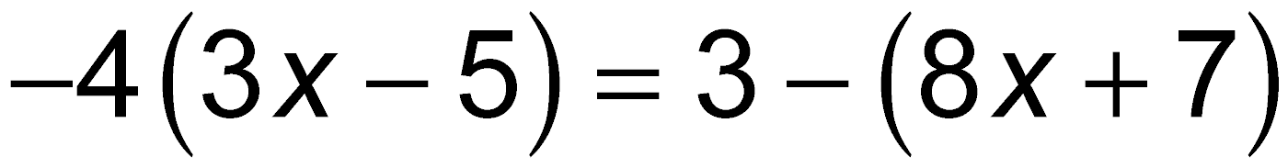
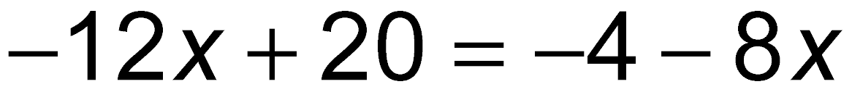
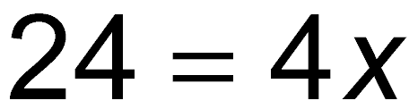
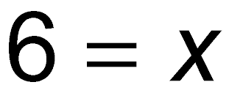
3. SOLVING EQUATIONS
Solve
Distributive property
Combine terms.
Add 4 to both sides.
Add 12x to both sides.
Combine terms.
Divide both sides by 4.
Solution set: {6}

Slide 12
3. SOLVING EQUATIONS
Solve
Multiply by 10, the LCD of all the fractions.
Distributive property
Combine terms.
Add –4x and –6 to both sides. Combine terms.
Divide both sides by –6.
Solution set: {–10}

Slide 13
3. SOLVING EQUATIONS
A man borrowed $2580 to buy new kitchen appliances for his
home. He will pay off the loan in 9 months at an annual simple
interest rate of 6.0%. How much interest will he pay?
He will pay $116.10 in interest.

Slide 14
Simple Inequalities
An equation is an equality. It states that the expression on the LHS of the
'=' sign is equal to the expression on the RHS.
An inequality is a statement in which the expression on the LHS is either
greater than (denoted by the symbol >) or less than (denoted by the
symbol <) the expression on the RHS.
For example, 5 = 5 or 5.v = 5.x are equations, while 5 > 3 and 5x > 3x
are inequalities which read, '5 is greater than 3' or ‘5x is greater than 3x‘
(for any positive value of x).

Slide 15
An inequality statement, such as x > 2, means all numbers greater than, but not including, 2. This statement is represented graphically as every point on the number line to the right of the number 2, as shown in the figure below.

Slide 16
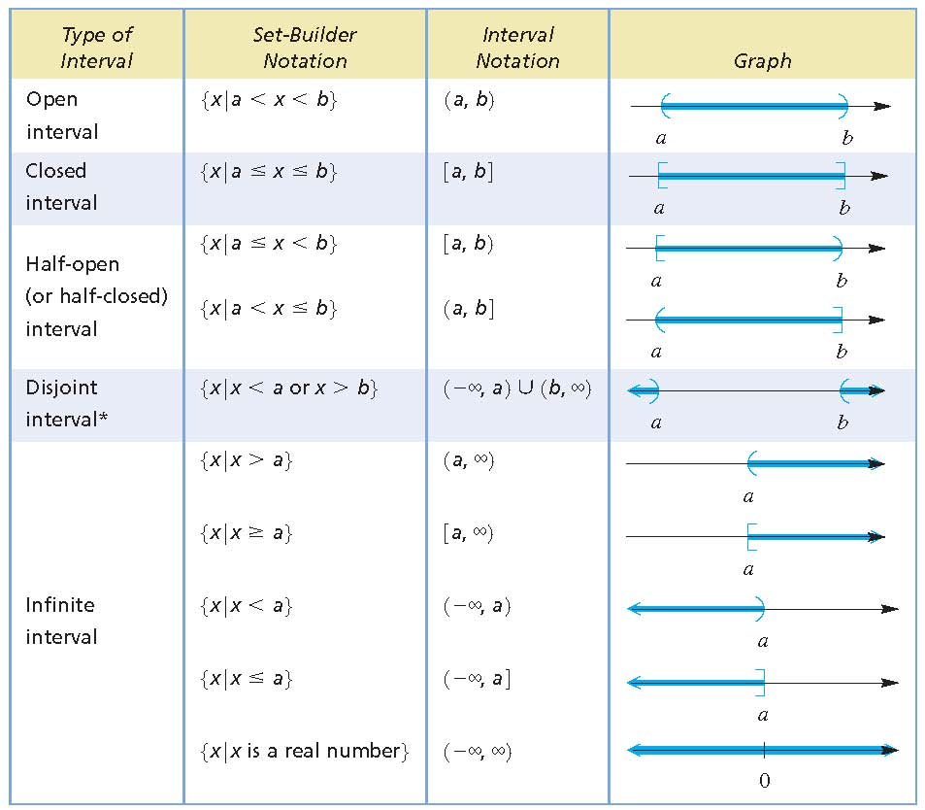
Type of Intervals

Slide 17
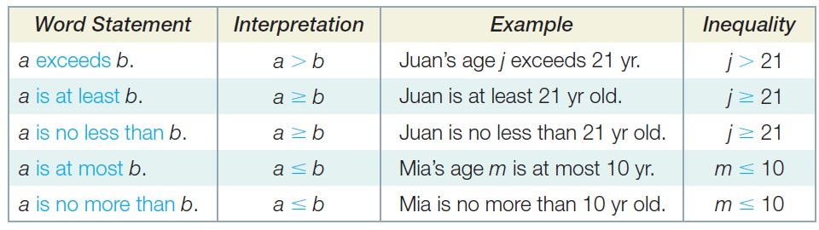
The table gives some common words and phrases you might see
in a problem that suggest inequality.

Slide 18
In economics, it is meaningful to talk about positive prices and quantities
only, so in solving inequalities, we shall assume that the variable in the
inequality is always positive.
The solution of an equation is a distinct value(s) for which the equation
statement is true. For example, x + 4 = 10 is true when x = 6 only. On
the other hand, the solution of an inequality is a range of values for
which the inequality statement is true; for example, x + 4 > 10 is true
when .x > 6.
SOLVING SIMPLE INEQUALITIES
Find the range of values for which the following inequalities are true,
assuming that x > 0. State the solution in words and indicate the solution on
the number line.

Slide 19
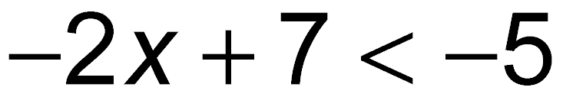
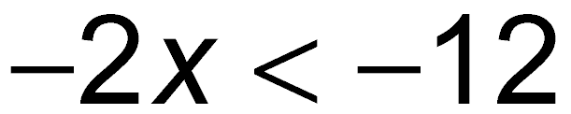
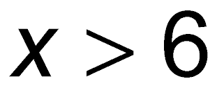
Subtract 7.
Divide by –2. Reverse the direction of the inequality symbol when multiplying or dividing by a negative number.
Solution set: {x|x > 6}

Slide 20
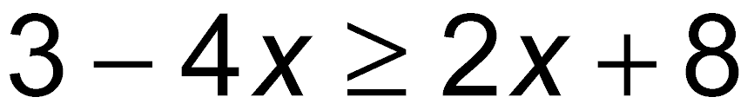
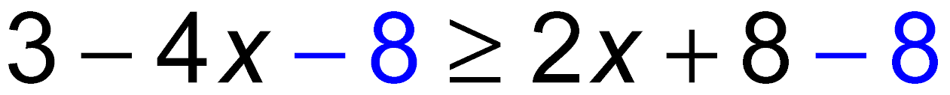
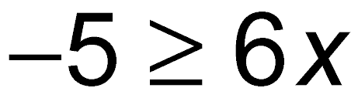
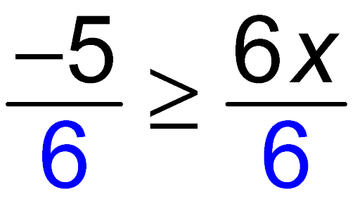
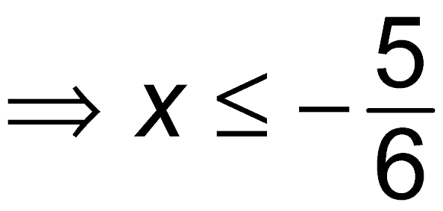
Subtract 8.
Add 4x.
Divide by 6.
Write the solution set in interval notation and graph it.
Solution set:

Slide 21
Break-Even point:
If the revenue and cost of a certain product are given by R = 45x and c = 30x + 5250, where x is the number of units produced and sold, at what production level does R at least equal C?
The break-even point is at x = 350. The product will at least break even if the number of units produced and sold is in the interval

Slide 22
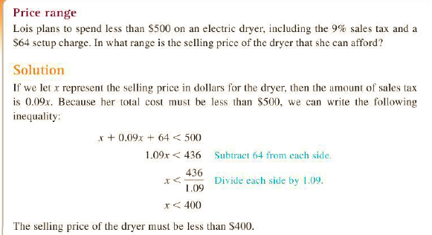

Slide 23
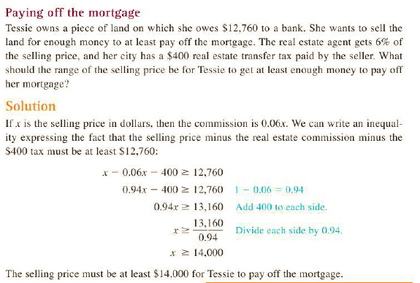

Slide 24
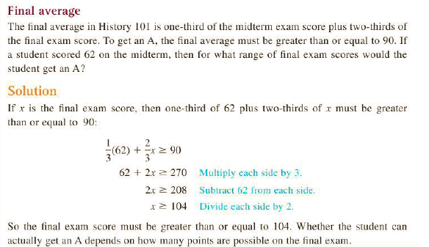

Slide 25
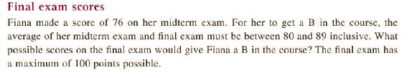
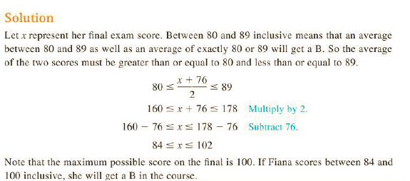

Slide 26
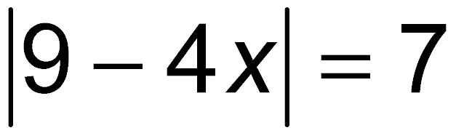
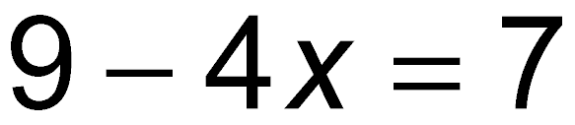
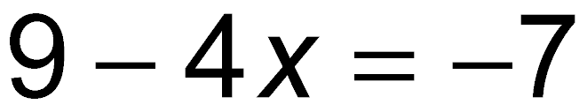
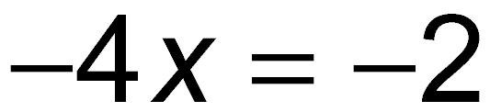
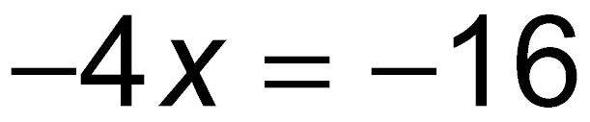
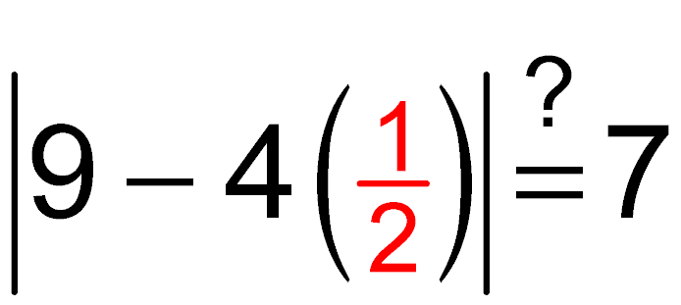
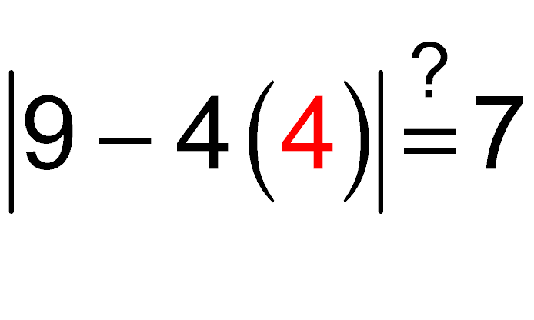
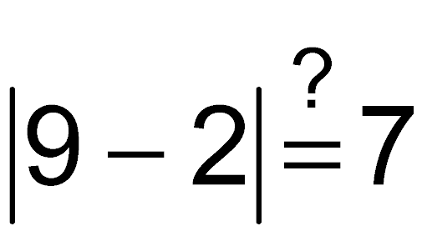
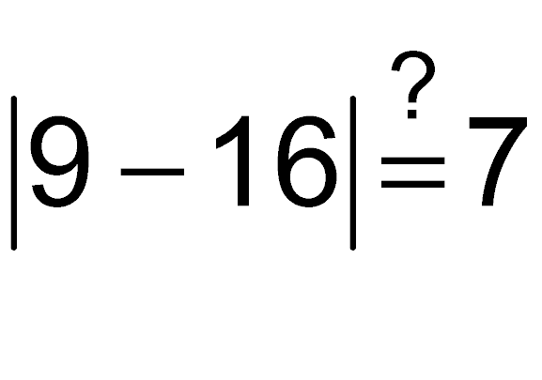
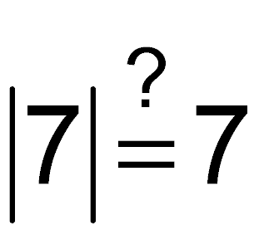
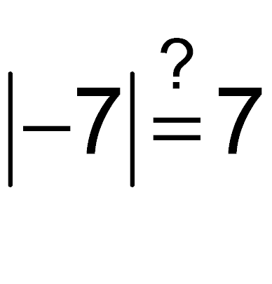
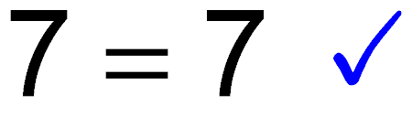
ABSOLUTE VALUE EQUATIONS
or
or
Subtract 9.
or
Divide by –4.
Now check.
Solution set:

Slide 27
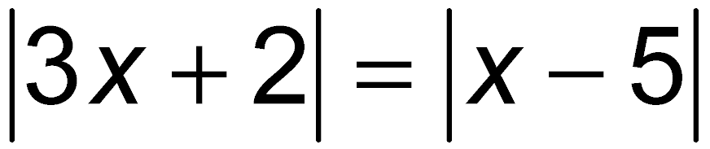
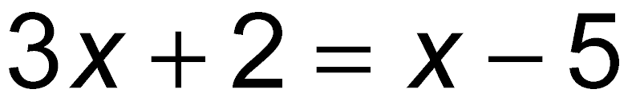
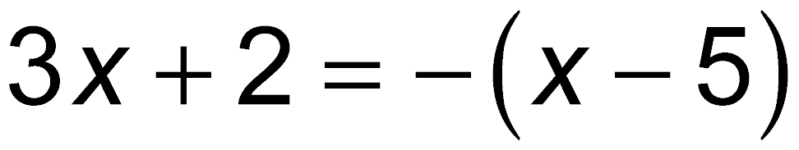
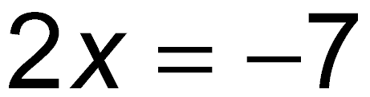
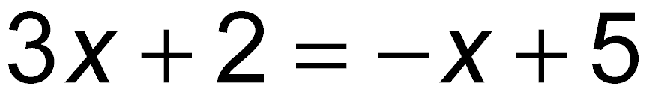
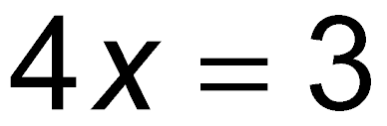
ABSOLUTE VALUE EQUATIONS
or
or
or
Now check each solution.
Both solutions check.
Solution set:

Slide 28
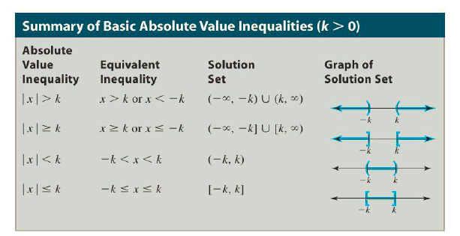
ABSOLUTE VALUE INEQUALITIES

Slide 29
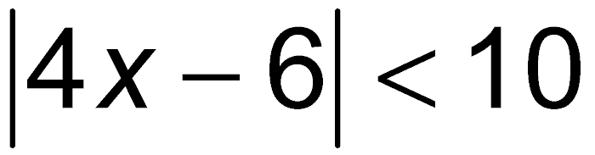
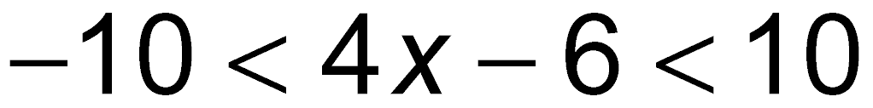
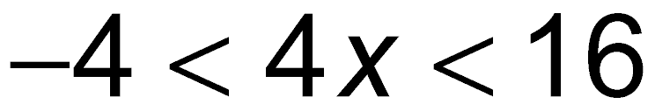
ABSOLUTE VALUE INEQUALITIES
Property 3
Add 6.
Divide by 4.
Solution set: (–1, 4)

Slide 30
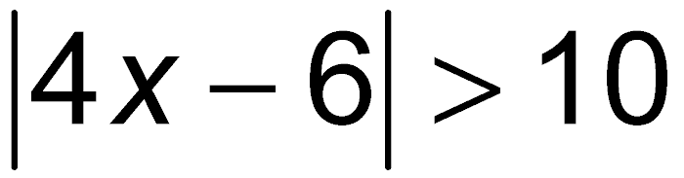
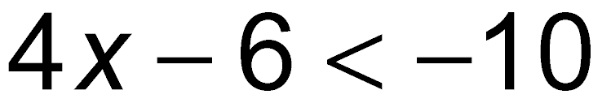
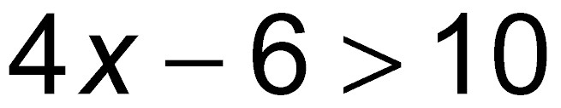
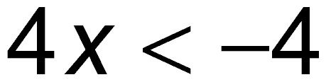
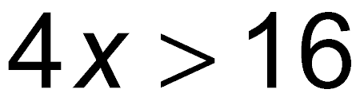
ABSOLUTE VALUE INEQUALITIES
or
Property 1
or
Add 6.
or
Divide by 4.
Solution set:

Slide 31
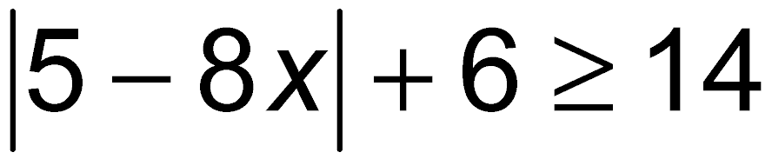





ABSOLUTE VALUE INEQUALITIES
Subtract 6.
or
Property 2
or
Subtract 5.
or
Divide by –8. Reverse the direction of the inequality symbol.
Solution set:

Slide 32

ABSOLUTE VALUE INEQUALITIES
The absolute value of a number will be 0 if that number is 0.
Therefore, is equivalent to 7x + 28 = 0.
Solution set: {–4}

Slide 33






ABSOLUTE VALUE INEQUALITIES –MODEL TOLERANCE
Suppose y = 5x – 2 and we want y to be within 0.001 unit of 6. For what values of x will this be true?
Write an absolute value inequality
Substitute 5x – 2 for y.
Property 3
Add 8.
Divide by 5.
Values of x in the interval (1.5998, 1.6002) will satisfy the condition.

Slide 34



Slide 35


Slide 36
4. CALCULATING PERCENTAGES
It takes only a glance at the business section of a newspaper or an annual report of a
company to see how extensively percents are applied in business.
Percents are the primary way of measuring change among business variables. For
example, a business might report “revenue is up 6% this year” or “expenses have
been cut by 2.3% this month.”
Interest rates, commissions, and many taxes are expressed in percent form. You may
have heard phrases like these: “Sunnyside Bank charged 12% on the loan,” “A real
estate broker made 5% commission on the sale of the property,” or “The state
charges a 6 1/2 % sales tax.” Even price changes are frequently advertised as percents,
“Sears Dishwasher Sale—All Models, 25% off!”

Slide 37
To this point, we have learned that fractions and decimals are ways of representing
parts of a whole. Percents are another way of expressing quantity with relation to a
whole. Percent means per hundred or parts per hundred and is represented by the
percent sign, %.
Percents are numbers equal to a fraction with a denominator of 100. Five percent, for
example, means five parts out of 100 and may be written in the following ways:
5 percent 5% 5 hundreds 0.05
Because percents are numbers expressed as parts per 100, the percent sign, %,
means multiplication by 1/100. Therefore, 25% means

Slide 38
When we speak of 5% of a number we mean
When we say a number increases by x%, then the increase in the number
The increased number
number + the increase =

Slide 39
EXAMPLES
Convert the following percentages to decimals
a) 44% b) 233% c) 56.4% d) .68% e) %
Remove the percent sign and move the decimal point two places to the left.
44% =.44
233% = 2.33
56.4% = .564
.68% =.0068
% = .125%

Slide 40
Convert the following decimals or whole numbers to percents.
a) .5 b) 3.7 c) .044 d) 7 e) 6
.5 = 50%
3.7 = 370%
.044= 4.4%
7 =700%
6 =6.5=650%

Slide 41
EXAMPLES
An automobile salesman earns an 8% commission on every
car he sells. How much does he earn on a car that sells for
$12,000?
The salesman earns $960.

Slide 42

Interpreting Percents from a Graph
In 2012, Americans spent about $53.3 billion on their pets. Use the
graph to determine how much of this amount was spent on pet
supplies/medicine. Round the answer to the nearest tenth of a
billion dollars.
About $12.7 billion was spent.

Slide 43
Percent is often used to express a change in some quantity. Buying an item that has been marked up and getting a raise at a job are applications of percent increase. Buying an item on sale and finding population decline are applications of percent decrease.
To solve problems of this type, we use the following equation.

Slide 44
a. A cost-of-living salary increase caused Keith’s monthly salary to go from $1300 to $1352. What percent increase was this?
The increase in salary was 4%.

Slide 45
b. The price of a concert ticket changed from $54.00 to $51.30. What percent decrease was this?
The decrease was 5%.

Slide 46
MATHEMATICS FOR ECONOMICS Graphs and Functions
INSTRUCTOR: Professor MIHAELA PAUN

Slide 47
Formulas and Functions
A formula is an equation involving two or more variables. Consider the uniform
motion formula D = RT. If you know the value of R (rate) and the value of T (time),
you can determine the value of D (distance).
We may also call this formula a function.
A function is a rule for determining the value of one variable from the values of one
or more other variables. We say that the first variable is a function of the other
variable(s).
Formulas and functions are used to model real-life situations.
So D is a function of R and T. We also say that D = RT expresses D as a function
of R and T.
Formulas and functions are used to model real-life situations. The function D = RT
models the relationship between distance, rate, and time in uniform motion.

Slide 48

Applied problems in mathematics often involve solving an equation. The equations for some problems come from known formulas, while in other problems we must write an equation that models a particular problem situation.
Jeannie Fung bought a Ford Mustang GT for a total cost of $18,966, including sales
tax. If the sales tax rate is 9%, then what amount of tax did she pay?

Slide 49

A group of hikers from Tulsa hiked down into the Grand Canyon in 3 hours 30 minutes. Coming back up on a trail that was 4 miles shorter, they hiked 2 mph slower and it took them 1 hour longer. What was their rate going down?

Slide 50
The Cartesian Coordinate System
If x and y are real numbers then (x, y) is called an ordered pair of real numbers. The
numbers x and y are the coordinates of the ordered pair, with x being the first
coordinate or abscissa, and y being the second coordinate or ordinate.
Just as every real number corresponds to a point on the number line, every ordered
pair of real numbers (a, b) corresponds to a point P in the xy-plane. For this reason,
ordered pairs of numbers are often called points.
So a and b are the coordinates of (a, b) or the coordinates of the point P. Locating the
point P that corresponds to (a, b) in the xy-plane is referred to as plotting or graphing
the point, and P is called the graph of (a, b).
In general, a graph is a set of points in the rectangular coordinate system.

Slide 51


Slide 52



Linear Equations in Two Variables SLOPE OF A LINE

Slide 53

FINDING THE SLOPE

Slide 54

FINDING THE SLOPE

Slide 55

FINDING THE SLOPE

Slide 56

FINDING THE SLOPE

Slide 57



Point-Slope Form
The graph of a linear function is a straight line. The figure shows the
line passing through the fixed point (x_{1,}y₁) having slope m. Assuming
that the line has a slope guarantees that it is not vertical.
Let (x,y) be any other point on the line. Since the line is not vertical,
x – x₁ not 0. By the definition of slope, the slope of this line is

Slide 58

FINDING THE SLOPE

Slide 59

Slope-Intercept Form

Slide 60

Slope-Intercept Form

Slide 61

Slope-Intercept Form

Slide 62

Summary

Slide 63

EXAMPLES

Slide 64

EXAMPLES

Slide 65


EXAMPLES

Slide 66

EXAMPLES

Slide 67


Slide 68


Slide 69


Slide 70



Slide 71


Slide 72


Slide 73


Slide 74


Slide 75


Slide 76
MATHEMATICS FOR ECONOMICS Non Linear Functions
INSTRUCTOR: Professor MIHAELA PAUN

Slide 77
THE FUNCTION CONCEPT
If you spend $10 on gasoline, then the price per gallon determines the number of
gallons that you get. There is a rule: The number of gallons is $10 divided by the price
per gallon.
The number of hours that you sleep before a test might be related to your grade on
the test, but does not determine your grade. There is no rule that will determine
your grade from the number of hours of sleep.
If the value of a variable y is determined by the value of another variable x, then y is a
function of x. The phrase “is a function of ” means “is determined by.”
If there is more than one value for y corresponding to a particular x-value, then y is not
determined by x and y is not a function of x.

Slide 78

THE FUNCTION CONCEPT

Slide 79

THE FUNCTION CONCEPT

Slide 80

THE FUNCTION CONCEPT

Slide 81

THE FUNCTION CONCEPT

Slide 82

THE FUNCTION CONCEPT

Slide 83

THE FUNCTION CONCEPT

Slide 84


Slide 85




Slide 86






Slide 87






Slide 88

SQUARE ROOT PROPERTY

Slide 89

COMPLETING THE SQUARE
Solving quadratic equations by factoring is limited to equations that we can factor.
However, we can solve any quadratic equation by completing the square and then using the square root property.

Slide 90


Slide 91


QUADRATIC FORMULA

Slide 92



Slide 93



Slide 94

EXAMPLE

Slide 95

EXAMPLE

Slide 96


EXAMPLE

Slide 97

EXAMPLE

Slide 98



EXAMPLE

Slide 99




Slide 100


EXAMPLE

Slide 101



EXAMPLE

Slide 102



Slide 103


Slide 104


Slide 105


Slide 106



Slide 107

EXAMPLE

Slide 108



Slide 109


Slide 110


EXAMPLE

Slide 111




Slide 112


EXAMPLE

Slide 113




Slide 114

EXAMPLE

Slide 115



Slide 116

EXAMPLE

Slide 117



Slide 118

EXAMPLE

Slide 119


Slide 120



Slide 121


Slide 122
MATHEMATICS FOR ECONOMICS COMBINATORIAL ELEMENTS
INSTRUCTOR: Professor MIHAELA PAUN

Slide 123

SETS
The Fundamental Counting Principle
Let’s say that the cafeteria lunch special includes a choice of sandwich and dessert.
In the terminology of counting, choosing a sandwich is an event and choosing a
dessert is another event. Suppose that there are three outcomes, ham, salami, or
tuna, for the first event and two outcomes, pie or cake, for the second event.
How many different lunches are available using these choices?
We can make a diagram showing all of the possibilities as in Fig. 11.11. This diagram is
called a tree diagram.
Considering only the types of sandwich and dessert, the tree diagram shows six
different lunches. Of course, 6 can be obtained by multiplying 3 and 2. This example
illustrates the fundamental counting principle.

Slide 124


Slide 125

SETS

Slide 126

SETS

Slide 127

SETS

Slide 128


Slide 129


EXAMPLE

Slide 130

EXAMPLE

Slide 131

PROBABILITY

Slide 132


PROBABILITY

Slide 133

PROBABILITY

Slide 134



PROBABILITY

Slide 135




Slide 136


Slide 137


Slide 138


Slide 139


Slide 140


Slide 141


Slide 142




Slide 143


Slide 144



Slide 145


Slide 146



Slide 147



Slide 148


Slide 149



Slide 150


Slide 151





Slide 152



Slide 153


Slide 154


Slide 155


Slide 156

COUNTING RULES IN PROBABILITY

Slide 157

COUNTING RULES IN PROBABILITY

Slide 158



Slide 159



Slide 160


Slide 161



Slide 162




Slide 163


Slide 164


Slide 165


Slide 166


Slide 167



Slide 168



Slide 169


Slide 170
MATHEMATICS FOR ECONOMICS ARITHMETIC AND GEOMETRIC SEQUENCES AND SERIES
INSTRUCTOR: Professor MIHAELA PAUN

Slide 171
SEQUENCES
In everyday life, we hear the term sequence in many contexts. We describe a sequence
of events, we make a sequence of car payments, or we get something out of
sequence.
We can think of a sequence of numbers as an ordered list of numbers. For example,
your grades on the first four algebra tests can be listed to form a finite sequence.
The sequence
10, 20, 30, 40, 50,…
is an infinite sequence that lists the positive multiples of 10.
We can think of a sequence as a list, but saying that a sequence is a list is too vague
for mathematics.
The definition of sequence can be clearly stated by using the terminology of functions.

Slide 172

SEQUENCES
When the domain is apparent, we will refer to either a finite or an infinite
sequence as a sequence.
The function ƒ(n) = n² with domain {1, 2, 3, 4, 5} is a finite sequence.
For the independent variable of a sequence, we usually use n (for natural number)
rather than x and assume that only natural numbers can be used in place of n.
For the dependent variable ƒ(n), we generally write a_{n} (read “a sub n”).
So this finite sequence is also defined by

Slide 173

SEQUENCES
The terms of the sequence are the values of the dependent variable a_{n}. We call a_{n}
the n^{th} term or the general term of the sequence.
The equation a_{n} = n² provides a formula for finding the n^{th} term. The five terms of this
sequence are a₁ = 1, a₂ = 4, a₃ = 9, a₄ = 16, and a₅ = 25.
We refer to a listing of the terms as the sequence. So 1, 4, 9, 16, 25 is a finite
sequence with five terms.

Slide 174

SEQUENCES

Slide 175



Slide 176


Slide 177

Arithmetic Sequences
An arithmetic sequence can be defined as a sequence in which there is a common
difference d between consecutive terms or it can be defined (as follows) by giving a
general formula that will produce such a sequence.
Note that a_{n} = a₁ + (n – 1)d can be written as a_{n} = dn + (a₁ - d).
So the terms of an arithmetic sequence can also be described as a multiple of the term
number plus a constant, (a₁ - d ).

Slide 178


Slide 179



Slide 180


Slide 181



Slide 182

Series and Summation Notation
If a worker starts at $20,000 per year and gets a $1200 raise each year for the next
39 years, then the total pay for 40 years of work is the sum of 40 terms of an
arithmetic sequence:
20,000 + 21,200 + 22,400 + ...+ 66,800
A sum of the terms of a sequence is an indicated sum before we have actually
performed the addition. The indicated sum of 40 years of salary is an example of a
series.

Slide 183

Series and Summation Notation

Slide 184


Slide 185



Slide 186



Slide 187



Slide 188


Slide 189



Slide 190


Slide 191


Slide 192

Geometric Sequences and Series
A geometric sequence is defined as a sequence in which there is a constant ratio r
between consecutive terms. The formula that follows will produce such a sequence.

Slide 193



Slide 194


Slide 195


Slide 196



Slide 197


Slide 198


Slide 199


Slide 200


Slide 201

EXAMPLE

Slide 202
MATHEMATICS FOR ECONOMICS LINEAR ALGEBRA

Slide 203


SYSTEMS OF EQUATIONS

Slide 204


Slide 205

SYSTEMS OF EQUATIONS

Slide 206


Slide 207



Slide 208


Solving Systems of Linear Equations by Elimination

Slide 209


Slide 210


Slide 211


Slide 212


Slide 213


Slide 214


Slide 215


Slide 216


Slide 217


Slide 218

MATRICES
Twenty-six female students and twenty-four male students responded to a survey on
income in a college algebra class. Among the female students, 5 classified themselves
as low-income, 10 as middle-income, and 11 as high-income. Among the male
students, 9 were low-income, 2 were middle-income, and 13 were high income.
Each student is classified in two ways, according to gender and income.
This information can be written in a matrix:
In this matrix we can see the class makeup according to gender and income. A matrix
provides a convenient way to organize a two-way classification of data.

Slide 219


MATRICES
In the above matrix we can see the class makeup according to gender and income. A
matrix provides a convenient way to organize a two-way classification of data.
A matrix is a rectangular array of real numbers. The rows of a matrix run horizontally,
and the columns run vertically. A matrix with only one row is a row matrix or row
vector, and a matrix with only one column is a column matrix or column vector.
A matrix with m rows and n columns has size m * n (read “m by n”). The number of
rows is always given first. For example, the matrix used to classify the students is a 2 *
3 matrix.

Slide 220


Slide 221





Slide 222


Slide 223


Solving Systems of Linear Equations by Matrix Methods

Slide 224

Solving Systems of Linear Equations by Matrix Methods

Slide 225

Solving Systems of Linear Equations by Matrix Methods

Slide 226

Solving Systems of Linear Equations by Back-Substitution

Slide 227
The Gaussian Elimination Method
The rows of an augmented matrix represent the equations of a system.
Since the equations of a system can be written in any order, two rows of an
augmented matrix can be interchanged if necessary.
Since multiplication of both sides of an equation by the same nonzero number
produces an equivalent equation, multiplying each entry in a row of the augmented
matrix by a nonzero number produces an equivalent augmented matrix.
In the augmented matrix, elimination of variables is accomplished by adding the
entries in one row to the corresponding entries in another row. These two row
operations can be combined to add a multiple of one row to another, just as was done
in solving systems by addition.

Slide 228

The Gaussian Elimination Method
To solve a system of two linear equations in two variables using the Gaussian
elimination method, we use row operations to obtain simpler and simpler
augmented matrices. We want to get an augmented matrix that corresponds to a
system whose solution is obvious. An augmented matrix of the following form is the
simplest:
Notice that this augmented matrix corresponds to the system x = a and y = b, for
which the solution set is {(a, b)}.

Slide 229

The Gaussian Elimination Method
The diagonal of a matrix consists of the entries in the first row first column, second
row second column, third row third column, and so on. A square matrix with ones on
the diagonal and zeros elsewhere is an identity matrix:
The goal of the Gaussian elimination method is to convert the coefficient matrix (in
the augmented matrix) into an identity matrix using row operations.
If the system has a unique solution, then it will appear in the rightmost column of the
finaln augmented matrix.

Slide 230


Slide 231


Slide 232


Slide 233



Slide 234


Slide 235


Slide 236


Slide 237


Slide 238



Slide 239


Slide 240



Slide 241



Slide 242



Slide 243



Slide 244


Slide 245



Slide 246


Slide 247



Slide 248

Solving Systems of Equations Using Matrix Inverses
A system of n linear equations in n unknowns could be written as a matrix equation of
the form AX = B, where A is a matrix of coefficients, X is a matrix of variables, and B is
a matrix of constants.
If A⁻¹ exists, then we can multiply each side of this equation by A⁻¹. Since matrix
multiplication is not commutative in general, A⁻¹ is placed to the left of the matrices on
each side:

Slide 249



Slide 250

The Determinant of a 2 x 2 Matrix
Before we can solve a system of equations by using determinants, we need to learn
what a determinant is and how to find it. The determinant of a square matrix is a
real number associated with the matrix. Every square matrix has a determinant.
The determinant of a 1 x 1 matrix is the single entry of the matrix.
For a 2 x 2 matrix the determinant is defined as follows.

Slide 251


Slide 252


Slide 253


Slide 254


Slide 255


Slide 256


Slide 257


Slide 258


Slide 259


Slide 260



Slide 261


Slide 262



Slide 263
CALCULUS
How do algebra and calculus differ?
The two words static and dynamic probably come as close as any to expressing the
difference between the two disciplines.
In algebra, we solve equations for a particular value of a variable a static notion.
In calculus, we are interested in how a change in one variable affects another variable
a dynamic notion.
Basic to the study of calculus is the concept of a limit. This concept helps us to
describe, in a precise way, the behavior of f(x) when x is close, but not equal, to a
particular value c.

Slide 264

LIMITS
We have often dealt with a problem like this: “Find the value of the function f (x)
when x = a. ”
The underlying idea of “limit,” however, is to examine what the function does near x =
a, rather than what it does at x = a.

Slide 265

LIMITS

Slide 266


LIMITS

Slide 267



LIMITS

Slide 268

LIMITS

Slide 269


LIMITS

Slide 270



Slide 271



Slide 272



Slide 273



Slide 274


Slide 275


Slide 276


Slide 277




Slide 278


Slide 279


Slide 280


Slide 281



Slide 282



Slide 283






Slide 284



Slide 285


Slide 286


Slide 287



Slide 288


Slide 289


Slide 290



Slide 291


Slide 292


Slide 293


Slide 294


Slide 295


Slide 296


Slide 297




Slide 298



Slide 299



Slide 300



Slide 301



Slide 302



Slide 303


Slide 304


Slide 305


Slide 306


Slide 307



Slide 308



Slide 309


Slide 310


Slide 311


Slide 312



Slide 313


Slide 314


Slide 315




Slide 316



Slide 317



Slide 318


Slide 319



Slide 320


Slide 321



Slide 322
FUNCTIONS OF SEVERAL VARIABLES
Recall that a function consists of a set of inputs called the domain, a
set of outputs called the range, and a rule by which each input
determines exactly one output.
For all of the functions studied previously, both the inputs and
outputs were real numbers. We now extend the concept of function
to the case when the inputs are ordered pairs of real numbers.

Slide 323


FUNCTIONS OF SEVERAL VARIABLES

Slide 324

FUNCTIONS OF SEVERAL VARIABLES

Slide 325

FUNCTIONS OF SEVERAL VARIABLES

Slide 326


Slide 327



Slide 328


Slide 329

PARTIAL DERIVATIVES

Slide 330


PARTIAL DERIVATIVES

Slide 331


Slide 332


PARTIAL DERIVATIVES

Slide 333


PARTIAL DERIVATIVES

Slide 334

PARTIAL DERIVATIVES

Slide 335

PARTIAL DERIVATIVES

Slide 336


Slide 337


Slide 338



Slide 339


Slide 340


Slide 341


Slide 342


Slide 343


Slide 344


Slide 345


Slide 346


Slide 347


Slide 348


